Slide 1

Chapter 11: From Sustainable Tourism to Regenerative Tourism

Slide 2
Chapter Outline
Introduction
Tourism and sustainable development
The three pillars of sustainability
Regenerative tourism
Summary
Case study/Discussion questions

Slide 3
Introduction
The UN World Tourism Organisation (UNWTO, 2024) noted an estimated 1.3 billion international tourist arrivals in 2023.
  What are the impacts of tourism on natural, socio-cultural and economic environments across the world?
  What is the appropriate balance between community needs, environmental conservation and economic growth?
The tourism industry is cognisant of the impacts it has on the environment, and sustainable development in tourism has been a topic of debate for a long time.
  Sustainable Tourism Indicators
  Overtourism
  Sustainable degrowth

Slide 4
Tourism and Sustainable Development
‘Sustainable development is development that meets the needs of the present without compromising the ability of future generations to meet their own needs’
(WCED, 1987, p. 41).

Slide 5
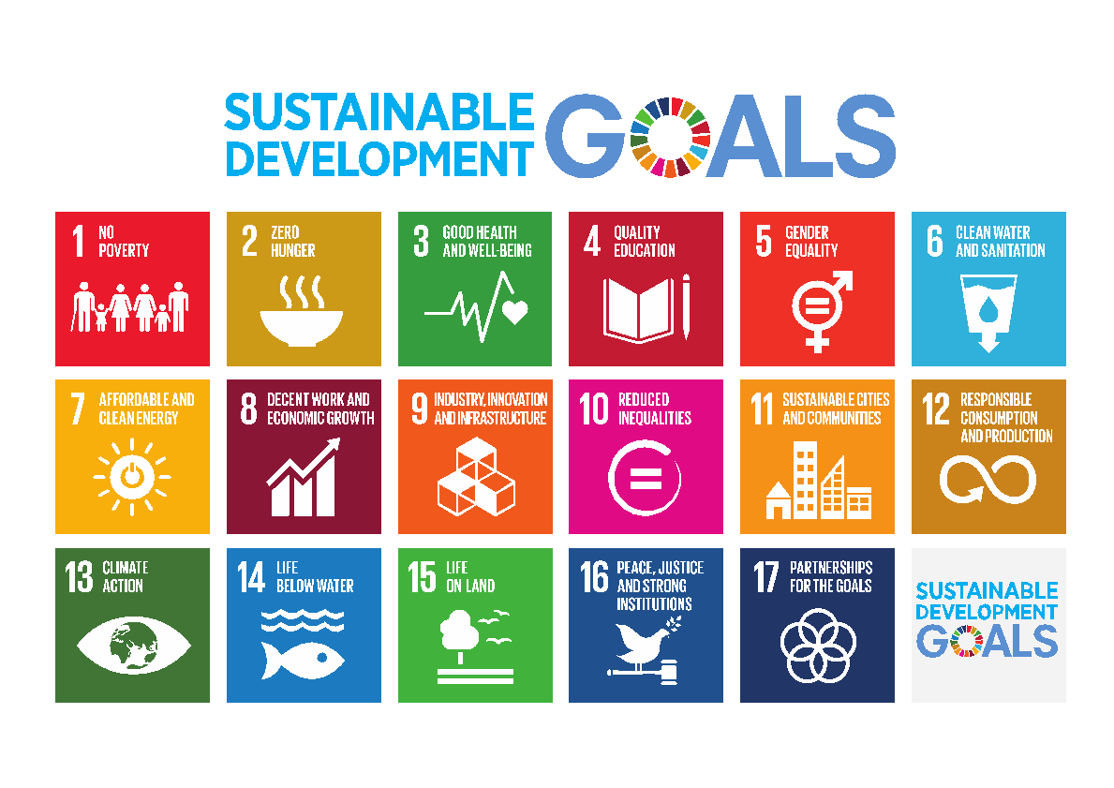
The UN Sustainable Development Goals (SDGs)
See https://sdgs.un.org/goals

Slide 6
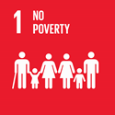
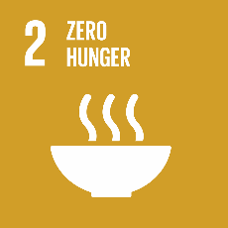


Examples: The SDGs and Tourism
 | Tourism can be linked to national poverty reduction strategies and entrepreneurship through low skills requirements and local recruitment.
 | Tourism can spur sustainable agriculture by promoting production, supplies to hotels, and sales of local products to tourists.
 | Tax income generated from tourism and visitors' fees collected in protected areas can be reinvested in health care and services.
 | Capacity and skills need to be built to ensure the tourism sector can prosper and provide job opportunities for youth, women and those with special needs.
From Table 11.0: Tourism and the Sustainable Development Goals (Source: UNWTO and UNDP, 2017, pp. 16-17; UN Tourism, n.d.a.)
Notes:
Now let us delve into some examples of how the tourism industry can address each of the SDGs.

Slide 7
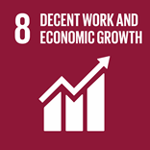
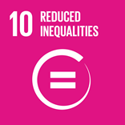
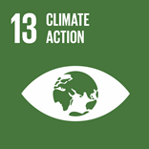

Examples: The SDGs and Tourism
 | Decent work opportunities in tourism, particularly for youth and women, and policies that favour better diversification through tourism value chains can enhance tourism’s positive socio-economic impacts. Target 8.9 specifically focuses on the ability of tourism to create jobs.
 | Sustainable tourism can engage local populations and all stakeholders in tourism development and contribute to urban renewal and rural development.
 | Tourism stakeholders can play a critical leading role in fighting climate change by reducing their carbon footprints.
 | Tourism can help foster multicultural and interfaith tolerance and understanding, and peace in post-conflict societies.
From Table 11.0: Tourism and the Sustainable Development Goals (Source: UNWTO and UNDP, 2017, pp. 16-17; UN Tourism, n.d.a.)

Slide 8
Tourism and Sustainable Development
SDG Summit 2023
Members gathered for an assessment on the progress of the SDGs towards the goals set for 2030 (United Nations, 2023a).
Major finding: The climate crisis, a weak global economy, the COVID-19 pandemic, and current war and social conflicts have prevented progress towards the goals (United Nations, 2023b).
There is a need to strengthen collaborations and foster accountability among all stakeholders.

Slide 9
The Three Pillars of Sustainability
Society
Economy
Sustainability
Environment

Slide 10
Examples: The Three Pillars of Sustainability
Economy | Society | Environment
Revenue generation Job creation High rates of inflation Growth based on profit-making (not equity, fairness and justice) | Overtourism Crime Changing customs and norms Tourism workforce | Waste Pollution Land degradation Biodiversity loss

Slide 11
The Three Pillars of Sustainability
The COVID-19 pandemic demonstrated that the tourism industry is far from sustainable, leading to growing calls to reset tourism.
Proposed solutions:
Need for political commitment and strong leadership to achieve the SDGs (Cheng et al., 2021)
Greater involvement and transparency in the SDGs’ implementation by international tourism organisations (Berbeka et al., 2024)
Shift to a four pillars framework for building resilience (Crotts et al., 2022).
Development of community-based strategies: creative tourism, inclusive tourism development and regenerative tourism.

Slide 12
Regenerative Tourism
The regeneration paradigm is founded on living systems thinking (Mang and Reed, 2012).
Living systems thinking suggests seeing the world as interconnected and dynamic systems.
Living systems thinking emphasises considering how the whole system adapts, has cycles of interaction and is in constant change.

Slide 13
Regenerative Tourism vs. Sustainable Development
Regenerative tourism diverges from sustainable development by leveraging tourism activities to foster capabilities of the communities, places and guests in harmony with the systems in which they operate (Bellato et al., 2022).
Both approaches may seek the well-being of future generations, but, while sustainable tourism aims to minimise social and environmental damage, regenerative tourism prioritises positive outcomes through integrative and equitable micro-scale initiatives (Duxbury et al., 2021).

Slide 14
Examples: Regenerative Tourism
Regenerative tourism initiatives include:
The Visit Flanders campaign which sought to create value beyond economic growth (Anderson, 2019).
Visitors to Aotearoa New Zealand being asked to abide by the Tiaki Promise, a pledge sourced from Māori principles (Lockhart, 2023).
CREATOUR in Portugal: a grassroot pilot project which was designed and implemented by locals for community benefits (Duxbury et al., 2021).
It has been argued that more of such efforts are crucial to address current challenges driven by value extraction rather than value generation

Slide 15
Summary
This chapter explored:
Tourism and sustainable development
The three pillars of sustainability
Regenerative tourism

Slide 16
Discussion Questions
Considering the three futuristic scenarios described above, what do you think will be the innovative forms of tourism that will need to be implemented?
What are some aspects of regenerative tourism that could be used to better prepare destinations for a ‘hot’ future?
Taking into consideration the new ‘hot’ world, how do you think other destinations will be affected, for instance, destinations that rely on natural resources or those that are based in cultural heritage?

